Slide 1
Understand the System
Steve Rabin
03.20.2018

Slide 2
Game AI = Human Authored Behavior
This is our singular strength as an industry.
We have honed many behavior architectures:
HFSMs, Behavior Trees, Utility, Planning,
Rule-Based Systems, Goal-Based Systems

Slide 3
Tools and Languages
To Define Behavior
Tools and Languages
To Understand Behavior

Slide 4
Why is the AI behaving like that right now?

Slide 5
What the AI would do in
any situation?

Slide 6
Ultimate Goal:
Understand the System

Slide 7
bool ShouldEat (bool hungry, bool unhappy)
{
if (hungry && !unhappy)
return true;
else
return false;
}

Slide 8
bool ShouldEat (bool hungry, bool unhappy)
{
if (hungry)
return true;
else
return false;
}

Slide 9
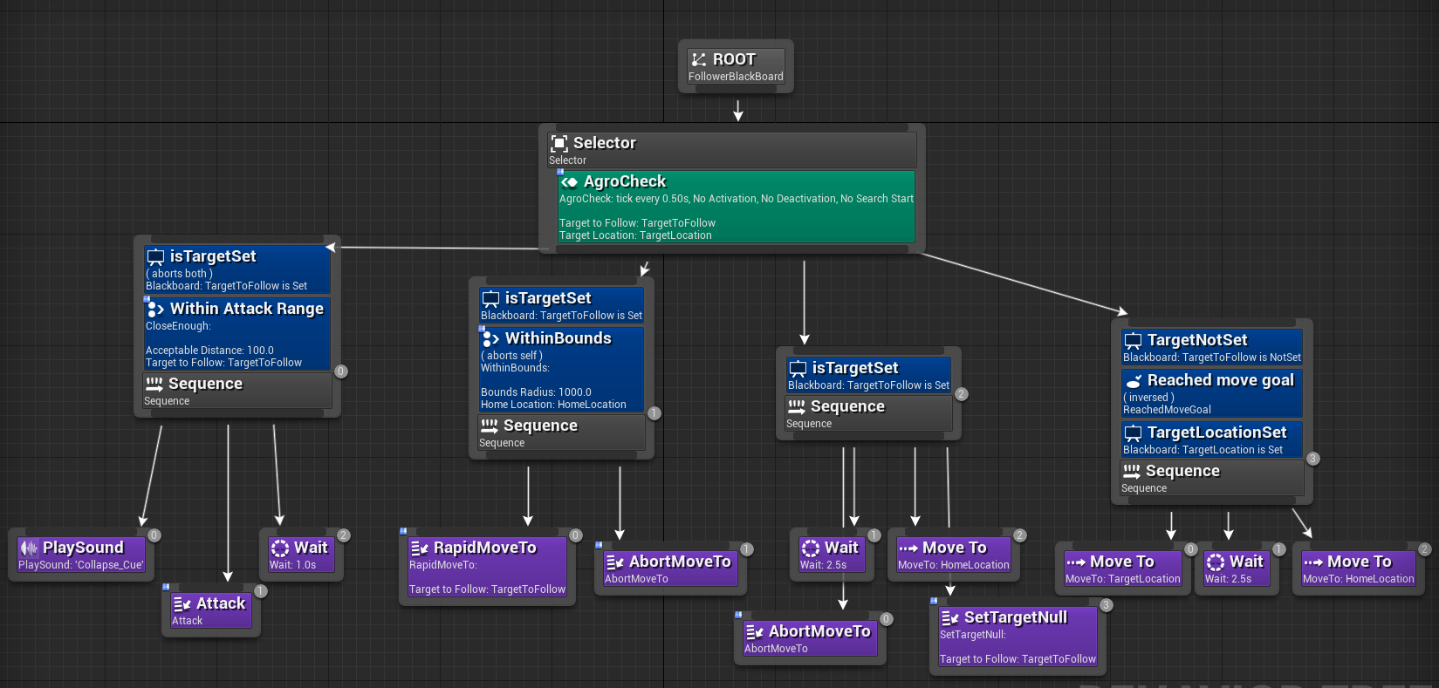
https://answers.unrealengine.com/questions/221987/how-to-activate-animation-state-from-a-task-in-beh.html

Slide 10
Behavior Tree
Selector
if Health low
if Ammo low
if Enemy near
if see Enemy
always true
Run Away
Reload
Punch
Shoot
Patrol
Tightly Coupled

Slide 11
Behavior Tree
Selector
if Health low
if Ammo low
if Enemy near
if see Enemy
always true
Run Away
Reload
Punch
Shoot
Patrol
BUGS

Slide 12
Behavior Tree
Selector
if Health low
if Health NOT low
if Health NOT low
if Health NOT low
if Health NOT low
Run Away
if Ammo low
if Ammo NOT low
if Ammo NOT low
if Ammo NOT low
Reload
if Enemy near
if Enemy NOT near
if Enemy NOT near
Punch
if see Enemy
if NOT see Enemy
Shoot
Patrol

Slide 13
Rule Based
1
if Health low
Run Away
if / else block
2
if Ammo low
Reload
Decision Tree
3
if Enemy near
Punch
if Health low
4
if see Enemy
Shoot
if Health low
Run Away
true
false
5
always true
Patrol
Run Away
if Ammo low
else if Ammo low
true
false
Reload
Reload
if Enemy near
true
false
else if Enemy near
Punch
if see Enemy
Punch
true
false
else if see Enemy
Shoot
Patrol
Shoot
Behavior Tree
else
Patrol
Selector
if Health low
if Ammo low
if Enemy near
if see Enemy
always true
Run Away
Reload
Punch
Shoot
Patrol

Slide 14
Run Away
Reload
Punch
Shoot
Patrol
1
1
1
1
1
SCORE
SCORE
SCORE
SCORE
SCORE
0
Health
100
0
Ammo
100
0
Enemy Dist
1000
0
Enemy Dist
1000
0
NULL
1

Slide 15
How do you understand
the system?
How do you understand what the
AI is going to do in every
possible situation?

Slide 16
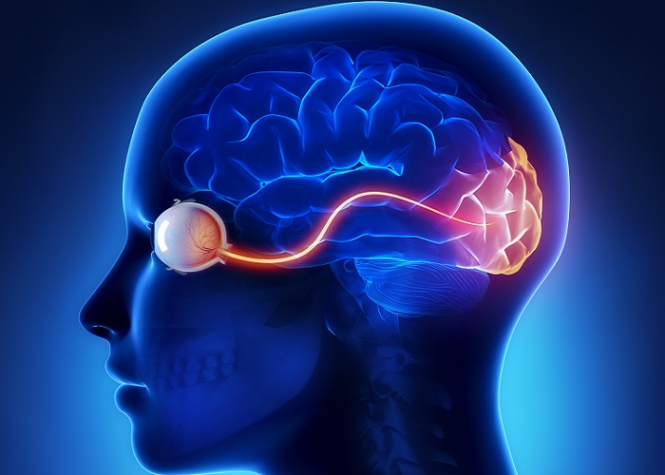

Slide 17
Situation Space with Action Boundaries
Run Away
Shoot
Reload
Punch
Patrol

Slide 18
Situation Space with Action Boundaries
Run Away
Health is low
Health is not low
Ammo is low
Ammo is not low
Enemy near
Enemy not near
See Enemy
Not see Enemy
Reload
Punch
Shoot
Patrol

Slide 19
Understand the system:
Play with the inputs
Watch the boundaries

Slide 20
Move from symbolic to interactive
Bret Victor’s
Media for Thinking the Unthinkable

Slide 21
Bret Victor

Slide 22
https://bost.ocks.org/mike/algorithms/

Slide 23
Feedback Idea
isTargetSet
true
false
WithinAttackRange
0
2000
90
WithinBounds
0
1510
2000
https://answers.unrealengine.com/questions/221987/how-to-activate-animation-state-from-a-task-in-beh.html

Slide 24
Feedback Idea
isTargetSet
true
false
WithinAttackRange
0
2000
90
WithinBounds
0
1510
2000
https://answers.unrealengine.com/questions/221987/how-to-activate-animation-state-from-a-task-in-beh.html

Slide 25
Feedback Idea
isTargetSet
true
false
WithinAttackRange
0
2000
94
WithinBounds
0
1510
2000
https://answers.unrealengine.com/questions/221987/how-to-activate-animation-state-from-a-task-in-beh.html

Slide 26
Feedback Idea
isTargetSet
true
false
WithinAttackRange
0
2000
98
WithinBounds
0
1510
2000
https://answers.unrealengine.com/questions/221987/how-to-activate-animation-state-from-a-task-in-beh.html

Slide 27
Feedback Idea
isTargetSet
true
false
WithinAttackRange
0
2000
102
WithinBounds
0
1510
2000
https://answers.unrealengine.com/questions/221987/how-to-activate-animation-state-from-a-task-in-beh.html

Slide 28
Feedback Idea
isTargetSet
true
false
WithinAttackRange
0
2000
106
WithinBounds
0
1510
2000
https://answers.unrealengine.com/questions/221987/how-to-activate-animation-state-from-a-task-in-beh.html

Slide 29
Feedback Idea
isTargetSet
true
false
WithinAttackRange
0
110
2000
WithinBounds
0
1510
2000
https://answers.unrealengine.com/questions/221987/how-to-activate-animation-state-from-a-task-in-beh.html

Slide 30
Run Away
Reload
Punch
Shoot
Patrol
1
1
1
1
1
SCORE
SCORE
SCORE
SCORE
SCORE
0
1
0
1
0
1
0
1
0
1
Health
Ammo
Enemy Distance
0
30
100
0
100
20
0
823
1000

Slide 31
Run Away
Reload
Punch
Shoot
Patrol
1
1
1
1
1
SCORE
SCORE
SCORE
SCORE
SCORE
0
1
0
1
0
1
0
1
0
1
Health
Ammo
Enemy Distance
0
30
100
0
100
20
0
823
1000

Slide 32
Run Away
Reload
Punch
Shoot
Patrol
1
1
1
1
1
SCORE
SCORE
SCORE
SCORE
SCORE
0
1
0
1
0
1
0
1
0
1
Health
Ammo
Enemy Distance
0
30
100
0
25
100
0
823
1000

Slide 33
Run Away
Reload
Punch
Shoot
Patrol
1
1
1
1
1
SCORE
SCORE
SCORE
SCORE
SCORE
0
1
0
1
0
1
0
1
0
1
Health
Ammo
Enemy Distance
0
30
100
0
30
100
0
823
1000

Slide 34
Run Away
Reload
Punch
Shoot
Patrol
1
1
1
1
1
SCORE
SCORE
SCORE
SCORE
SCORE
0
1
0
1
0
1
0
1
0
1
Health
Ammo
Enemy Distance
0
30
100
0
35
100
0
823
1000

Slide 35
Run Away
Reload
Punch
Shoot
Patrol
1
1
1
1
1
SCORE
SCORE
SCORE
SCORE
SCORE
0
1
0
1
0
1
0
1
0
1
Health
Ammo
Enemy Distance
0
30
100
0
40
100
0
823
1000

Slide 36
Situation Space with Action Boundaries
Run Away
Shoot
Reload
Punch
Patrol

Slide 37
Build interactive tools to
understand the system

